Slide 1
Dataset Collection Of Common Objects Within Campus
GROUP 1

Slide 2
AGENDA
Overview
Motivation and Goals
Scope of the Collection
Dataset Description
Dataset Quality
Intended Audience
Contributions
Usage and Applications

Slide 3
OVERVIEW
The purpose of collecting datasets related to objects found in a university environment is to facilitate research, development, and education in fields such as computer vision, machine learning, and image processing. These datasets are essential resources for creating and testing algorithms that can identify, manipulate, and understand objects and scenes within a university setting.

Slide 4
Motivation and Goals
This dataset collection serves multiple purposes in a university setting and image processing. It's designed for research, student learning, and practical security and resource management applications. It also encourages innovation, interdisciplinary collaboration, and the development of solutions for universities and beyond

Slide 5
Scope of the Collection
The scope of the dataset collection encompasses a wide range of objects and environments commonly encountered in a university, including classrooms boards, gym items, CPUs, projectors, wires and various academic materials. This comprehensive approach ensures the versatility and applicability of the functions applied on the dataset.

Slide 6
Dataset Description
This paper outlines the data collection process for a university object dataset and its image processing. High-resolution images were taken with mobile phones, considering lighting, angles, and settings. Pre-processing included resizing, color correction, and noise reduction. Various operations were applied, using tools like Jupyter Notebook, Google Drive, Google Colab, and Python libraries. Transparency and permissions from staff were maintained throughout the process.

Slide 7
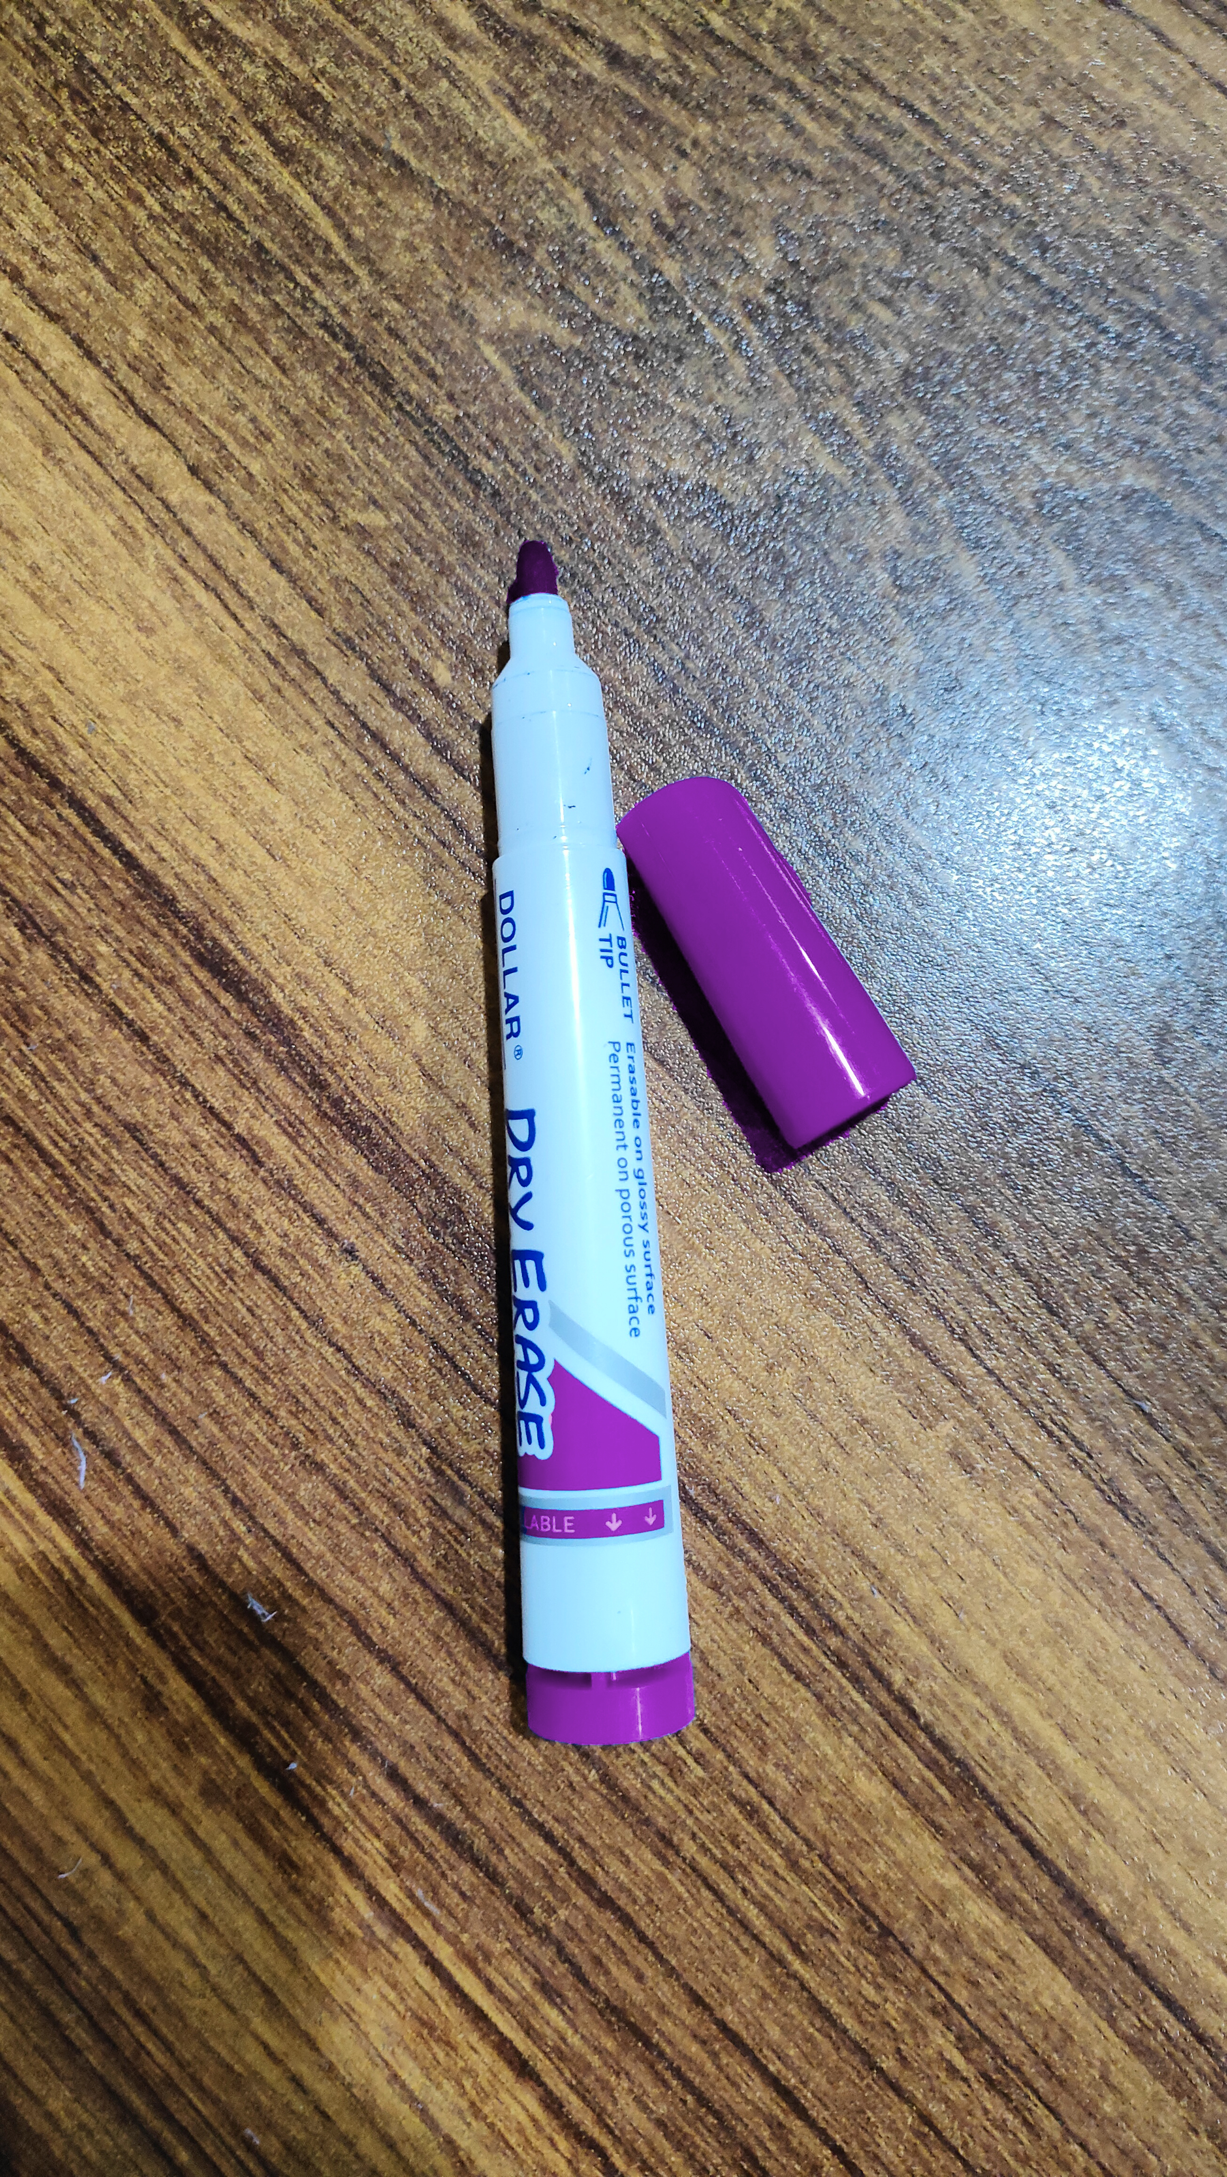
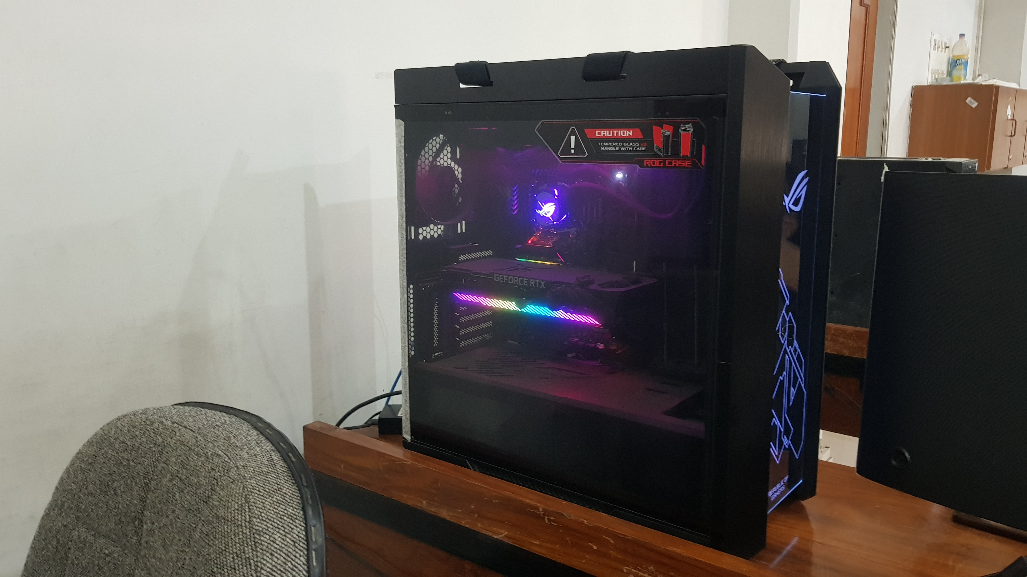

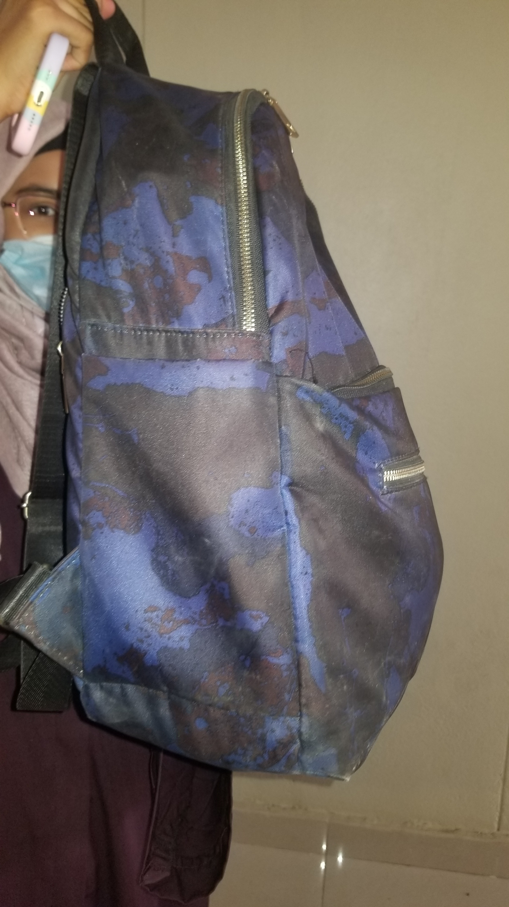
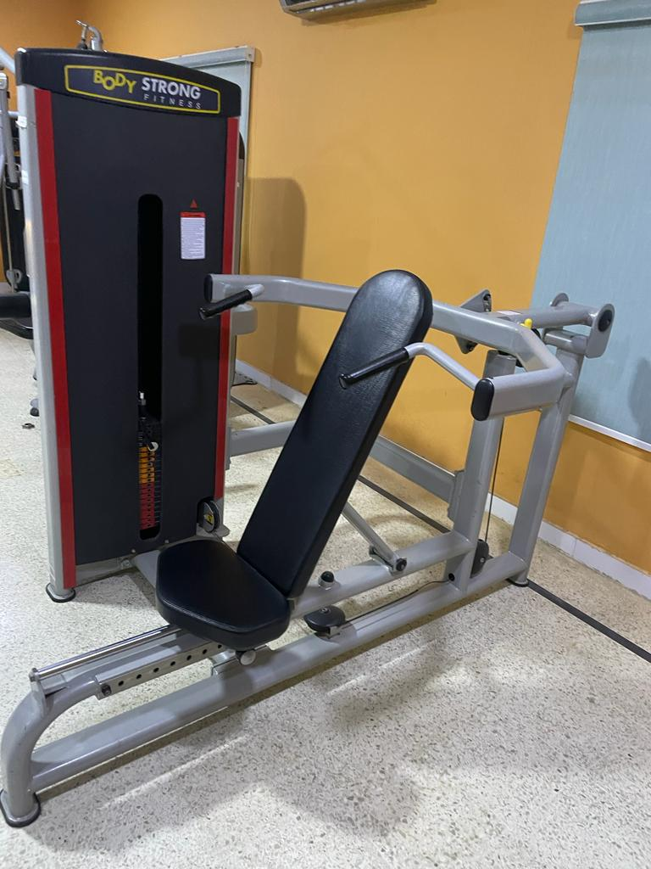
DATASET EXAMPLES
MARKERS
CPU
SNOOKER BALLS
BAGS
GYM EQUIPMENT

Slide 8
Dataset Quality
Datasets must capture diverse objects, scenes and scenarios to ensure robust algorithms. High-resolution images are preferred and a substantial number of images are collected to train and evaluate algorithms reflecting the diversity of university objects. Image processing operations such as transformation, color adjustment, bitwise operations and filtering are applied to the dataset. This multi-disciplinary process helps innovate computer vision and related fields, enabling security, automation and improved understanding of complex environments.

Slide 9
FEATURES OF DATASET
CPU
Monitors
Wires
Room Names
Gym Items
Chairs
AC
Bag
Board
Projector
Markers
Tables
Snooker Balls

Slide 10
OUTPUTS

Slide 11
AREAS OF FOCUS
INTENDED AUDIENCE
ACKNOWLEDGEMENT
This dataset of common university objects is useful for researchers, educators, and administrators to conduct research in computer vision, educational applications, and practical solutions.
We thank FAST NUCES for granting us permission to capture images of various objects on campus premises.

Slide 12
Usage and Applications
This dataset includes university object images for various purposes, including security, inventory management, research, education, and more. It contains statistics on samples and classes, sample images, and references to CV Lab manuals, making it valuable for research and innovation in academic settings.

Slide 13
Task Distribution
MEMBERS | CLASSES | ROLES
EMAAN SIDDIQUI | Snooker Balls | Report
FARZAN ANSARI | CPUS | Programming
MANAHIL FATIMA | Wires | Programming
ALISHBA SUBHANI | Gym Items | Programming
HAMZA SAMEER | Projectors | Programming
LOHIT ASHWA | Tables | Programming
MEMBERS | CLASSES | ROLES
ANAS AHMED | Room Names | Programming
ANMOL ZEHRA | Boards | Report
MANNAHIL MIFTAH | Air Conditioners | Report
USMAN YAQOOB | Markers | Presentation
HAIQA SHERAZ | Chairs | Programming
SONDOS SUHAIL | Bags | Presentation
FAHAD ZAHID | Monitors | Programming

Slide 14
Contributions
1
Diversity of Object Classes
2
Image Consistency
3
University Relevance
4
Machine Learning and Computer Vision
5
Diversity of Object Classes

Slide 15
THANK YOU

